Slide 1
Public Meeting Proposed Changes for September 2024
Phil Dupler – Director of Planning
1

Slide 2
The Goal
“Trinity Metro will redesign its bus network to improve the experience of our current riders, attract new riders, and enhance mobility for low-income residents through more frequent all-day service and more simple, direct routes.”
2

Slide 3
Route Level Analysis
Five routes carry over 50% of the ridership
17 routes carry less than 10% of the ridership
3

Slide 4
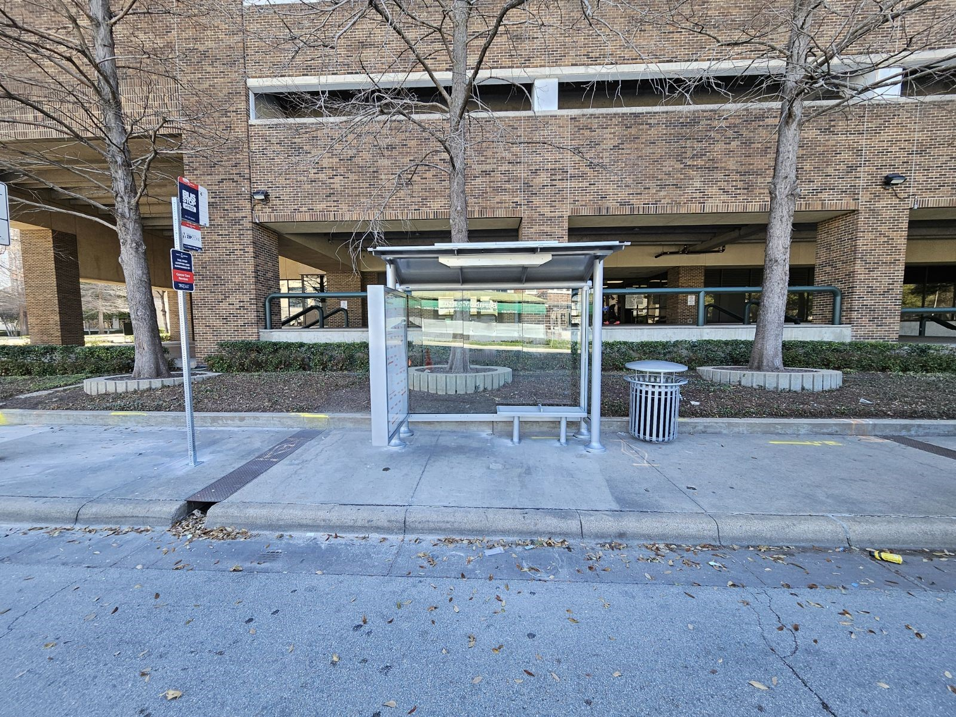
Proposed Changes September 2024
Route 5 – Increase frequency to 15 minutes
Route 15 – Later evening service
Route 28 – Replace, area serviced by Southeast ZIPZONE
Route 45 – Replace, area serviced by new ZIPZONE
Route 66X – Replace, area serviced by routes 6, 52, & 72
Route 23 – Replace in Fall 2024, serviced under ZIPZONE
Dash – Discontinue
Reduction in fare pricing
4

Slide 5
Route Level Analysis
Routes as a Percentage of Weekday Ridership
Route 5 – Extended to TCC South Campus and VA Clinic
Based on Public Feedback
Ridership actually up 9% over Pre-COVID
Recommend improving peak service to 15-minute
5

Slide 6
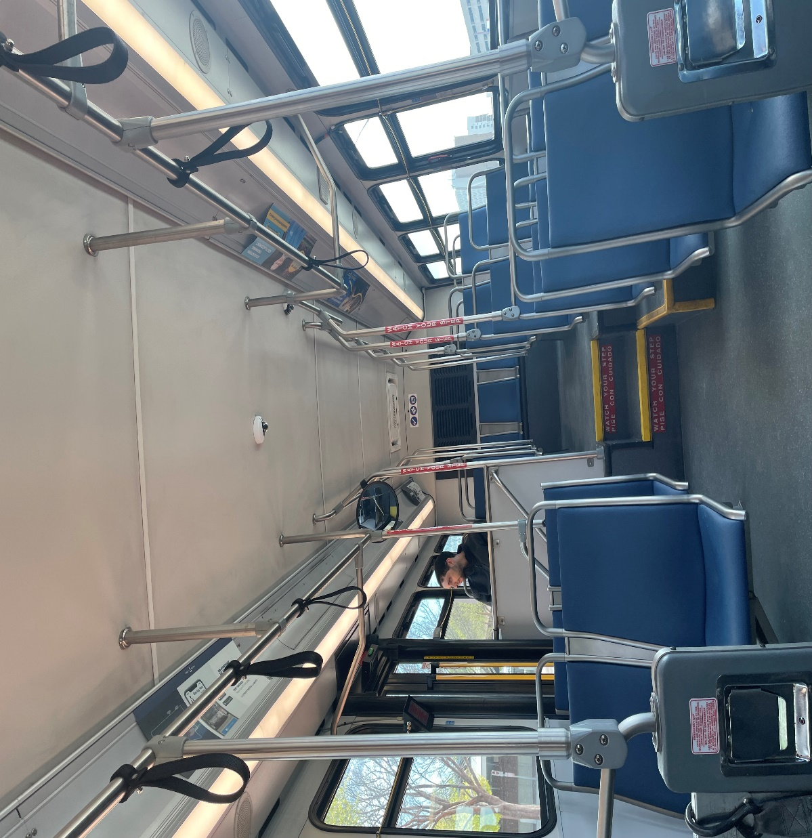
Ridership
Routes with less than 70 boardings each weekday
Route 28 – Hourly route, ridership of less than 50 boardings per day
Route 45 – Hourly route, ridership of 50-70 boardings per day
Route 66X – Lowest performing express route, less than 20 boardings per day
Route 23 – Hourly route, ridership of less than 12 boardings per day
6

Slide 7
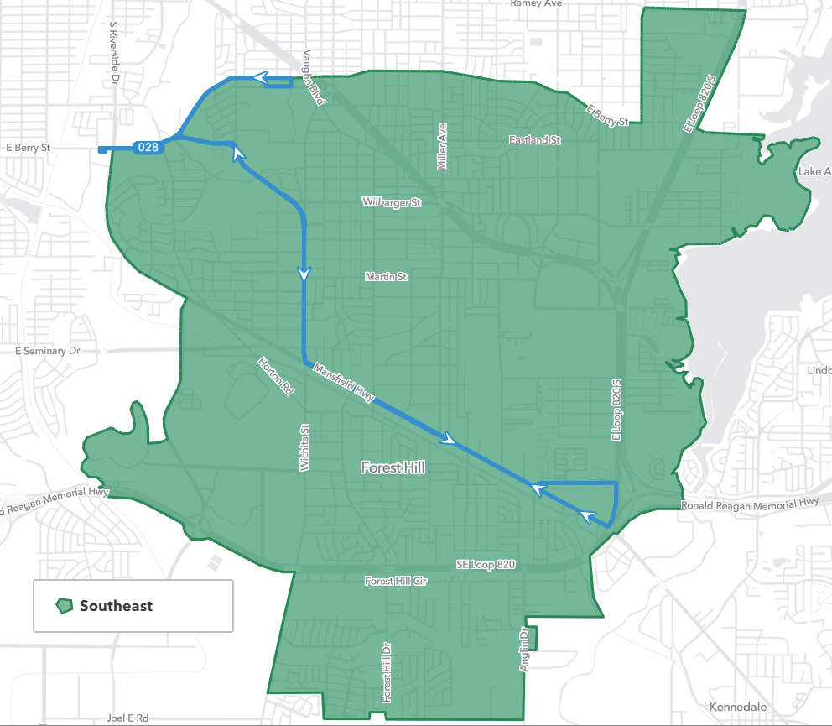
Southeast ZIPZONE Route 28
Walmart
Sierra Vista TC
Route 28 would be replaced with existing Southeast ZIPZONE
Riders can download the GoPass app to book trips on-demand
Southeast ZIPZONE serves major destinations like Walmart Supercenter and Sierra Vista Transfer Center.
Southeast ZIPZONE operating hours is Monday to Friday from 7A-7P
TCC South Campus
7

Slide 8
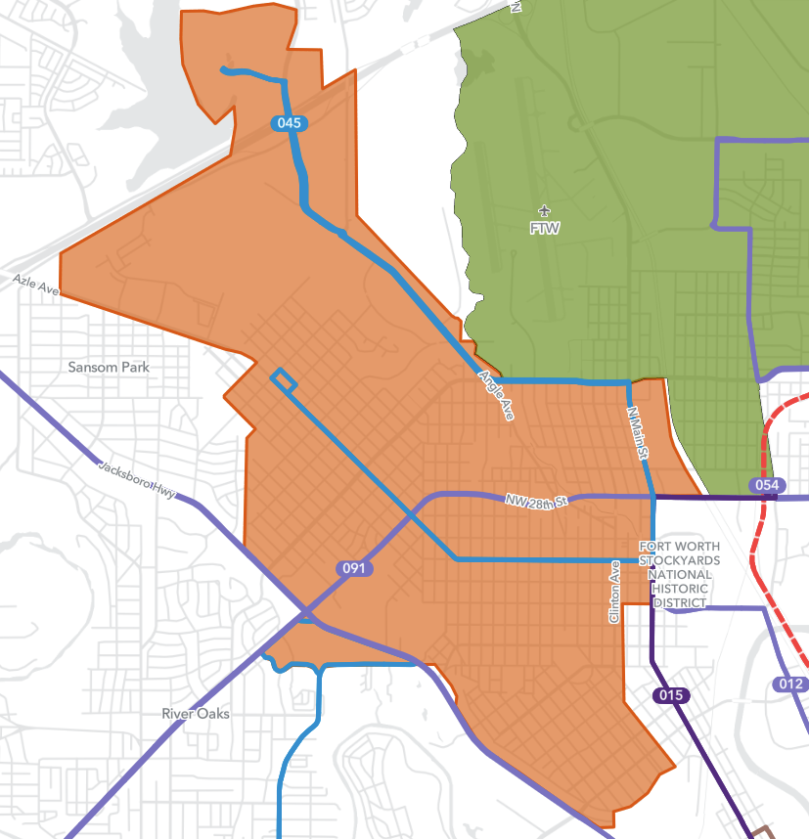
North Side ZIPZONE Route 45
TCC NW Campus
Proposed North Side ZIPZONE would replace Route 45
Serves additional residential areas between Northside Drive and 25th Street
Serves TCC Northwest Campus, Walmart Supercenter, Fiesta Mart
Connection to North Side Station for TEXRail
Community Center
Fiesta Mart
North Side Station
JPS
Northside HS
Walmart
Library
Community Center
8

Slide 9
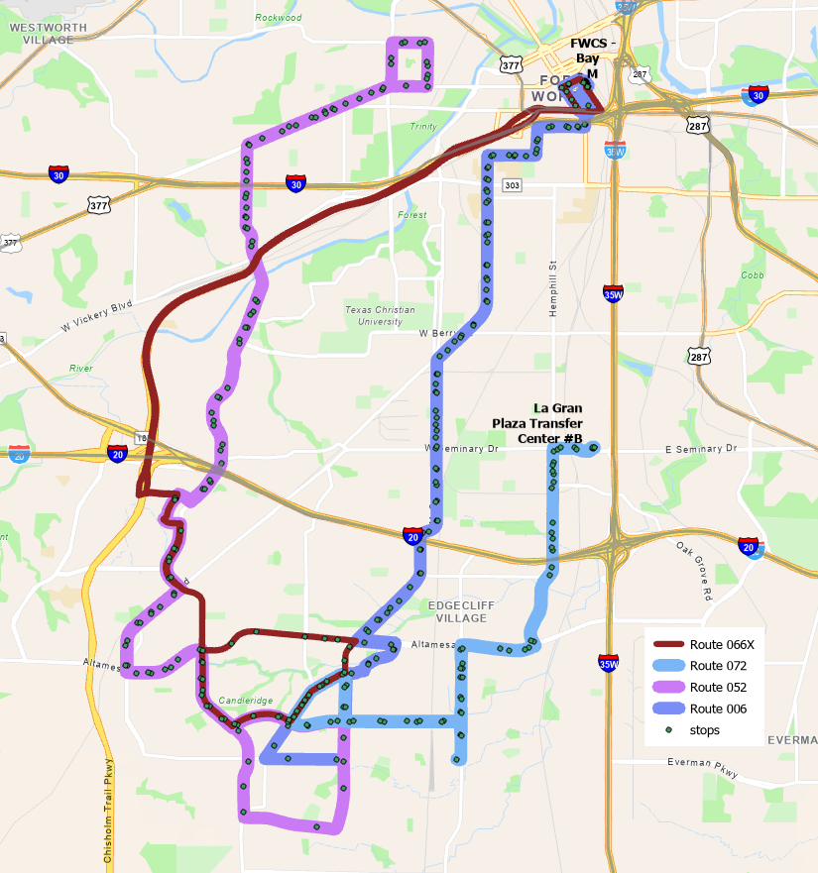
Route 66X
Lowest performing express route
Current service is peak only
Local routes 6, 52, and 72 serve area in SW Fort Worth
9

Slide 10
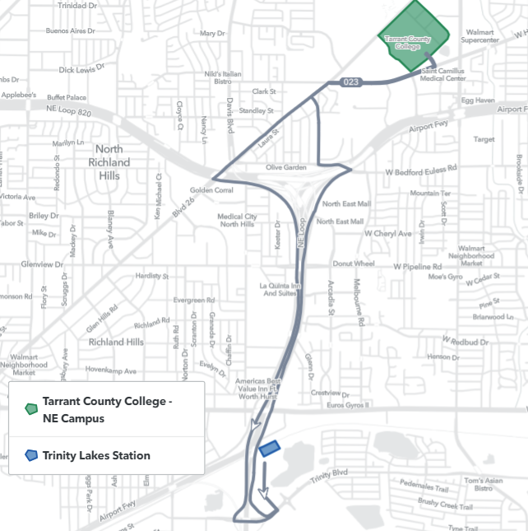
On-Demand Service Route 23
Route 23 service will be replaced by an on-demand service
Service will be available from Trinity Lakes Station to Tarrant County College NE-Campus only
10

Slide 11
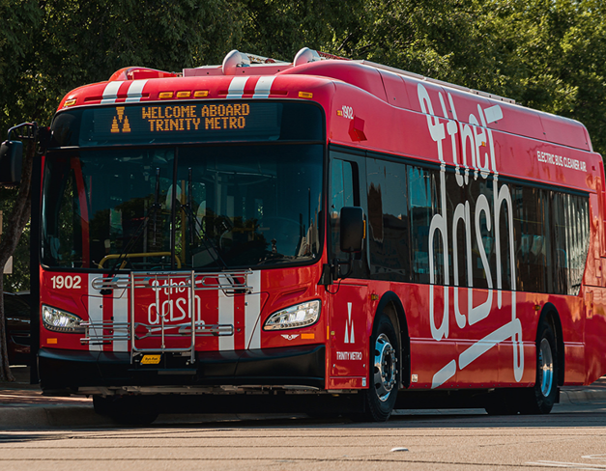
The Dash
BlueZones promotional pilot project to promote healthy lifestyles
Higher density/mixed use areas
Environmentally friendly electric buses
Walking/bicycling to bus stops
Ridership never grew
Launched pre-COVID
Stagnant post-COVID
Competes with Route 2 Camp Bowie
Funding partners chose to discontinue
Re-purpose the electric vehicles for the downtown Molly
11

Slide 12
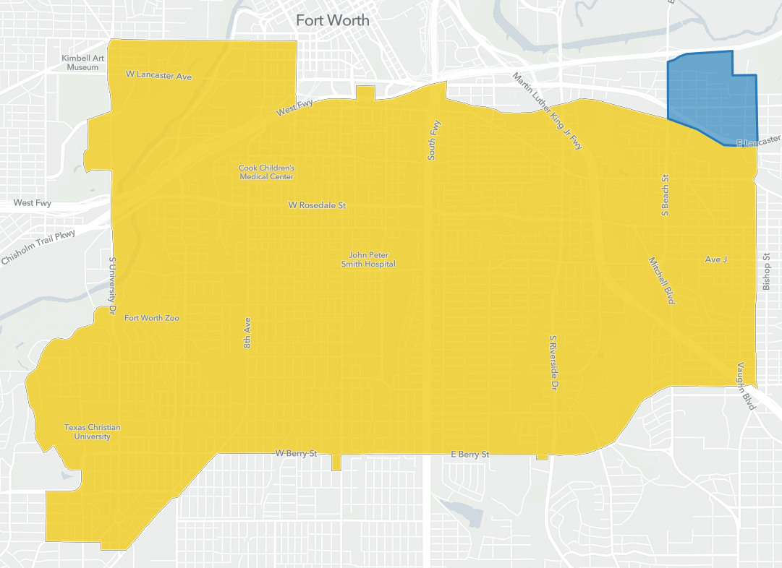
Southside ZIPZONE – Sycamore Heights
Southside ZIPZONE extension to include Sycamore Heights neighborhood.
Service will begin during the September 2024 service change
12

Slide 13
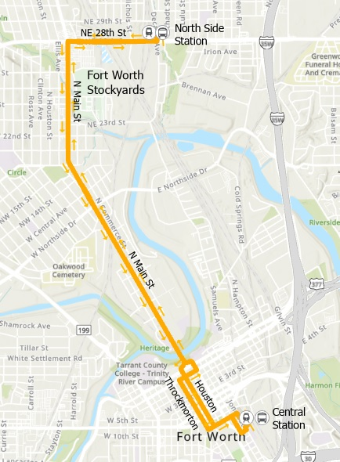
Route 15
Stockyards/North Main
Later Evening Service
One hour later (till 12:45am)
15 minute frequency all evening
13

Slide 14
Title VI
The Civil Rights Act of 1964 provides that no person shall be subjected to discrimination on the basis of race, color, or national origin under any program or activity that receives federal financial assistance
Watchful of unintended consequences
Route 5
North Side
ZIPZONE
Sycamore Heights
The Dash
Routes 23, 28, 45 & 66
14

Slide 15
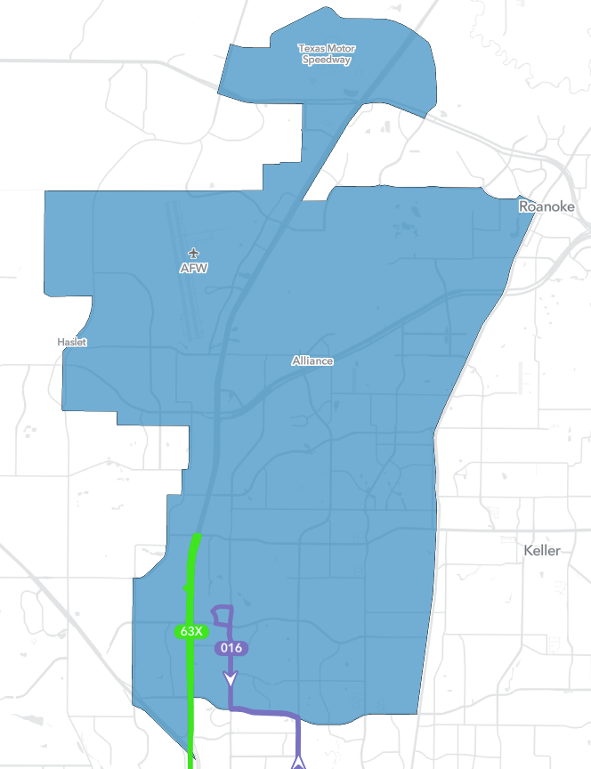
Alliance ZIPZONE
Starting in October 2024, Alliance ZIPZONE will no longer be serviced by LYFT
Riders will pay regular fare for On-Demand service
Hours: M-F 4:30AM to 7:30 PM Sa-Su 5:30AM to 7:30 AM and 4PM to 7:30 PM
Download the GoPass App to book and pay for your trip
15

Slide 16
Fare Collection Changes
Trinity Metro is seeking to update and modernize fare collection at the transit agency in order to create a simpler, easier-to-understand fare system that is more attractive to the public and will increase ridership in coming years.
Trinity Metro’s Information Technology Fare Collection team, working with consultants at HDR, has investigated fare structures and fare collection technologies utilized in the transit industry to develop an improved Fare Collection System that can support the agencies goals.
16

Slide 17
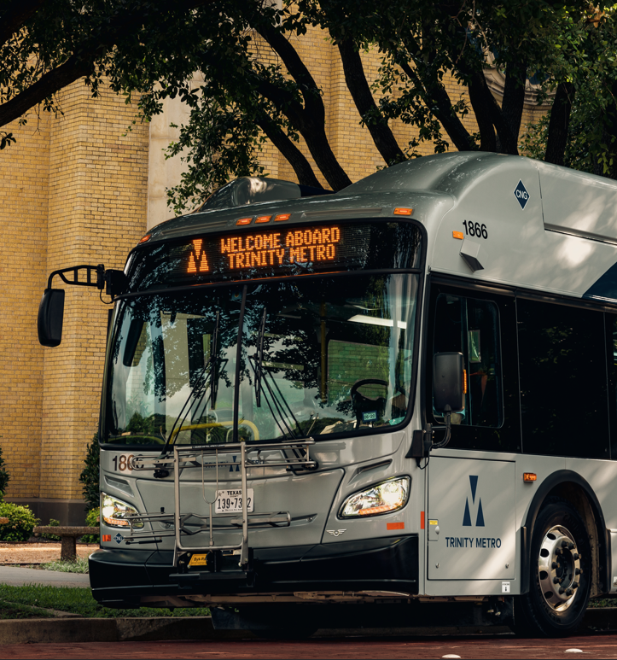
Proposed Regular Fares
 | Current Regular Fares | Proposed Regular Fares
Single Ride (Bus) | $2.00 | $2.00
Express Bus/Train | $2.50 | $2.00
ZIPZONE | $3.00 | $2.00
Day Pass | $5.00 | $4.00
7-Day Pass | $25.00 | $18.00
31- Day Pass | $80.00 | Not Offered
Annual Pass | $800 | Not Offered
17

Slide 18
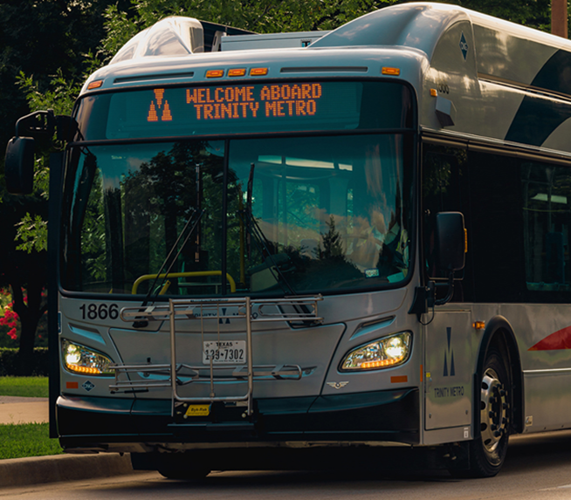
Proposed Reduced Fares
 | Current Reduced Fares | Proposed Reduced Fares
Single Ride (Bus) | $1.00 | $1.00
Express Bus/Train | $1.25 | $1.00
ZIPZONE | $3.00 | $2.00
Day Pass | $2.50 | $2.00
Paratransit | $4.00 | $4.00
7-Day Pass | $12.50 | $9.00
31- Day Pass | $40.00 | Not Offered
Annual Pass | $400 | Not Offered
18

Slide 19
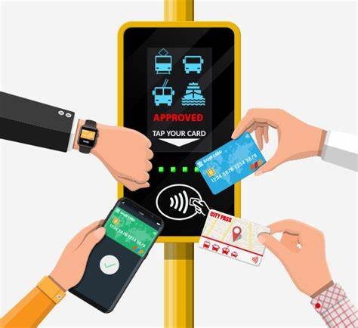
Account Based Ticketing (ABT)
Requires new Equipment
Funds are tied to an account
Tap and Board
Reduced fare on approval
Rides are charged on tap of ‘Token’
Allows Trinity Metro to introduce Fare Capping
Customer is always charged the best fare
Validators:
Buses, Paratransit vehicles, ZIPZONE vehicles, Platforms and Trains.
19

Slide 20
Fare Capping
Customer is charged a single-ride fare each time they ride ($2.00/$1.00).
Once they pay for two rides, all remaining rides on any vehicle are free for the rest of the day.
Once a customer pays the equivalent of a 7-day pass ($18.00/$9.00), all other rides for that 7-day period of time are free.
This is a cost savings for all of our customers, not just the ones that can afford the 7-day and 31-day passes previously offered.
20

Slide 21
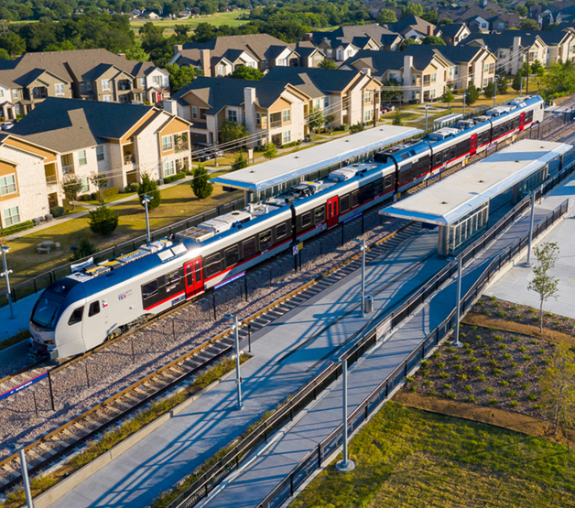
Key Benefits Review
Universal – Every current user receives opportunity for savings
Innovative - Pay with Apple Pay, Google Pay, Samsung Pay and smartwatches
Equitable – Low income and minority riders get more trips for less money
Simple - Fare system is MUCH easier to explain and use
21

Slide 22
Fare Equity Analysis
Compares impact of fare changes on protected groups
Everyone Saves Money!
Low Income group already leans toward purchasing the lowest cost fares and making the fewest trips possible
Minorities being the largest group save the most.
22

Slide 23
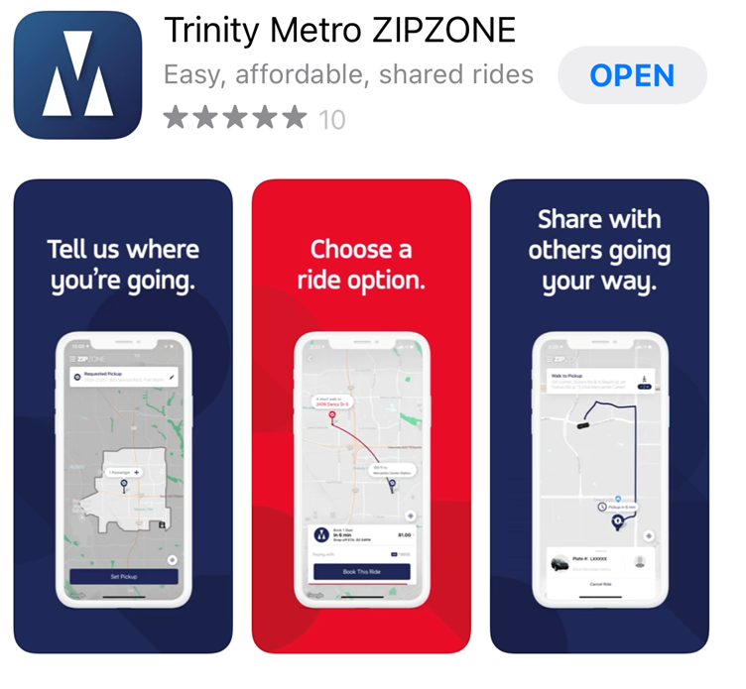
HOW TO USE ZIPZONE
Download the Trinity Metro ZIPZONE
mobile app on your smartphone (iOS or Android).
Add your payment information.
Within the app, type in your destination and wait for your ZIPZONE-branded van to pick you up and zip you away.
Or call Trinity Metro Customer Care at 817-215-8600, select the ZIPZONE option (press 5) and speak with a live representative.
It’s that simple. Zip in. Zip out.
23

Slide 24
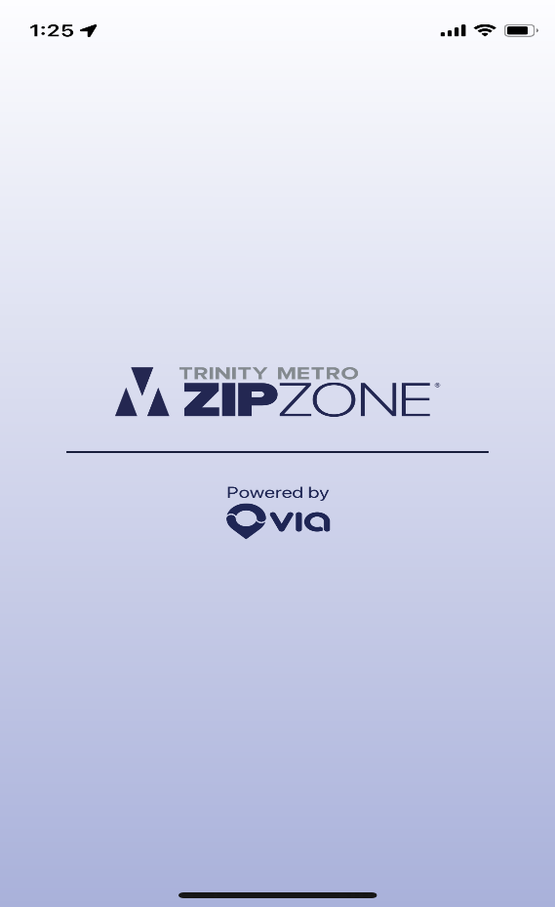
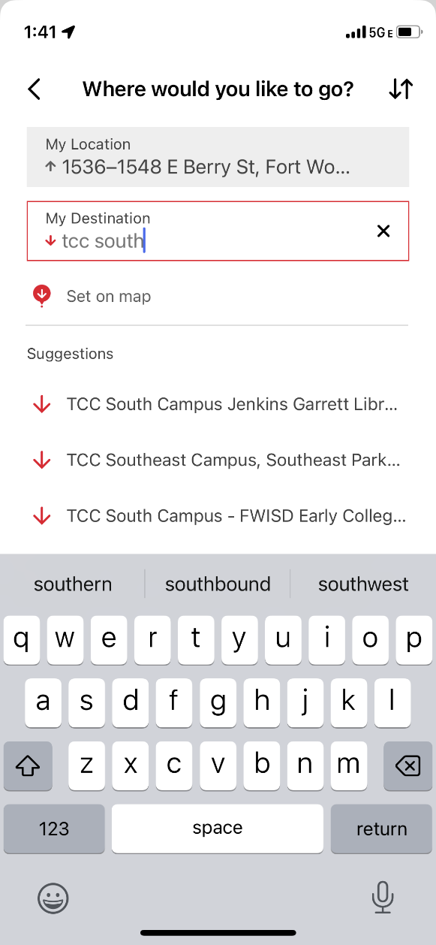
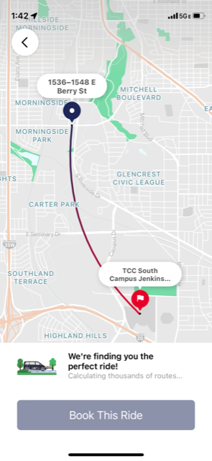
HOW TO BOOK ZIPZONE TRIPS
24

Slide 25
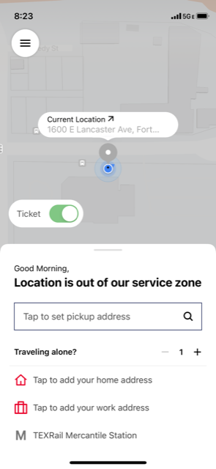
ALREADY HAVE A TICKET?
Enable Ticket Toggle
Adding Passengers
25

Slide 26
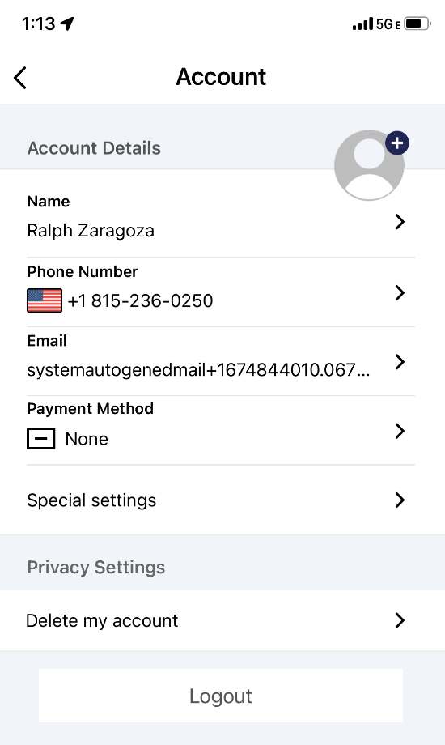
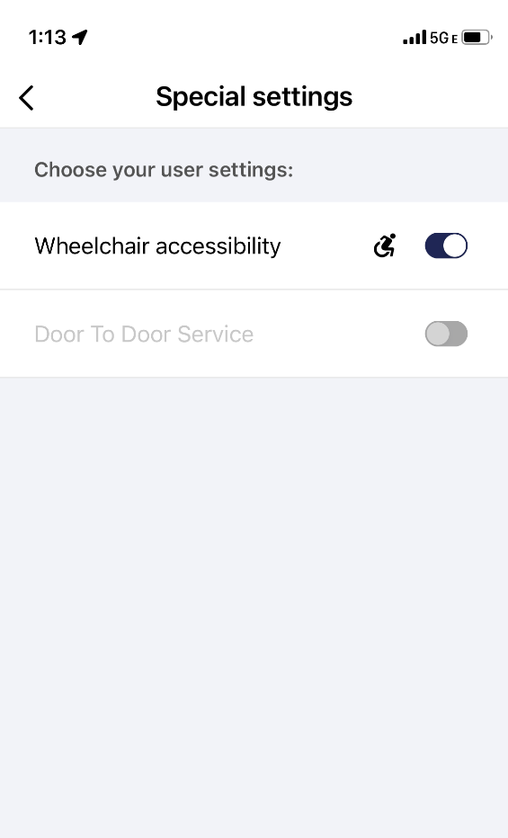
HOW TO BOOK WHEELCHAIR ACCESSIBLE TRIPS
234-567-8910
26

Slide 27
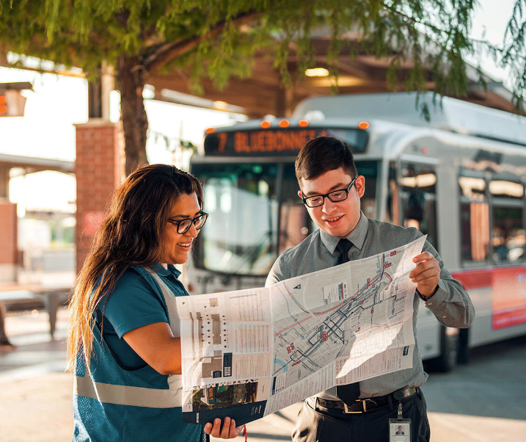
TRANSIT ENVOY
Trinity Metro Transit ENVOY provides education on all our services.
Transit 101 is a 30-minute transit education program that teaches individuals how to use Bus, Rail, ZIPZONE services.
ENVOY team offers personal, step-by-step instructions and can be customized to meet the requestor’s needs.
Available to participate in community events to engage current and future riders.
27

Slide 28
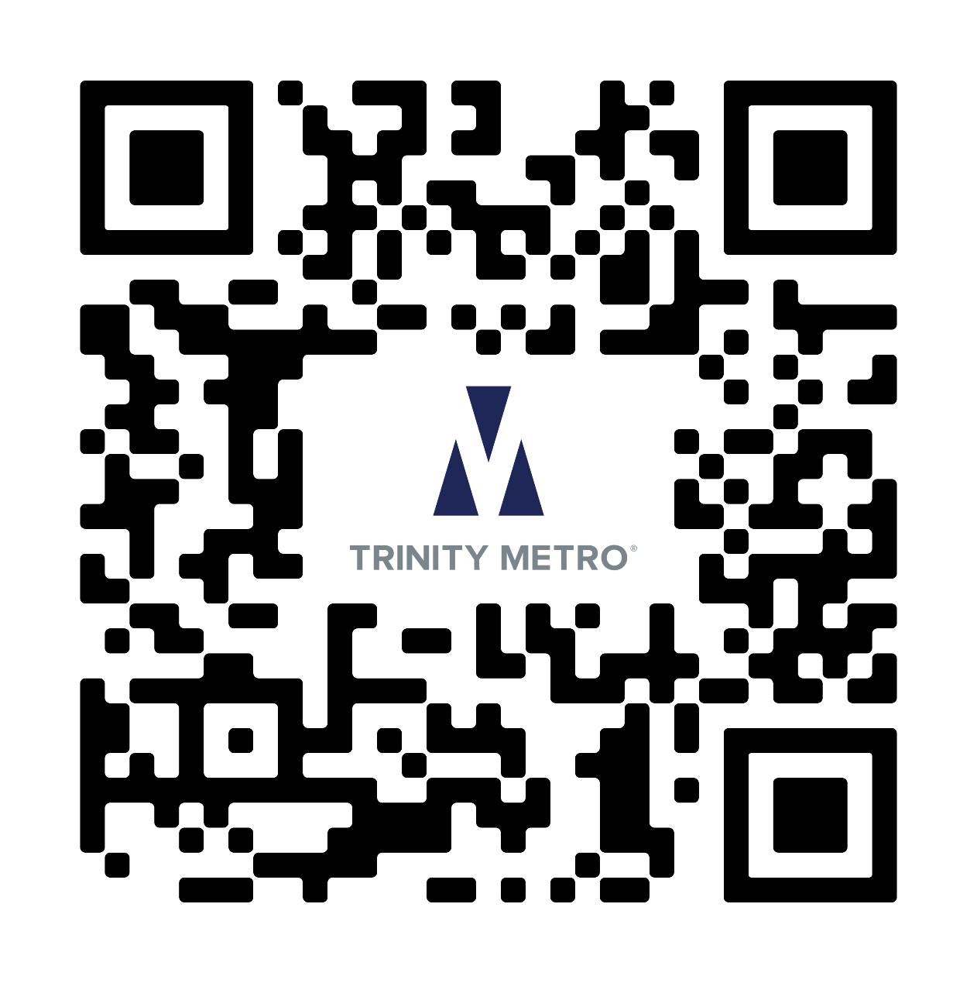
Public Comment
Please Respond by Monday, April 15, 2024
To submit a comment:
Send an email to
engage@ridetrinitymetro-engage.org
Write to Trinity Metro
801 Grove St,
Fort Worth, Texas, 76102,
Attn: Planning & Development
Call Trinity Metro’s Comment Line,
817-215-8793
28

Slide 29
ENGAGE
LEARN
+ SHARE
Trinity Metro is hosting community gatherings throughout 2024 to LEARN more about what our customers want and need.
We’re listening, and we hope you’ll join us.
29

Slide 30
ENGAGE
LEARN
+ SHARE
We want you to SHARE your comments,
ideas and concerns about what you need
from your transit agency.
We’re listening, and we hope you’ll join us.
30

Slide 31
ENGAGE
LEARN
+ SHARE
We want to LEARN how you
get around Fort Worth and Tarrant County
and how you use transit services.
We’re listening, and we hope you’ll join us.
31

Slide 32
ENGAGE
LEARN
+ SHARE
We want to LEARN what you like,
what you don’t like and how we can
improve our services to meet your needs.
We’re listening, and we hope you’ll join us.
32

Slide 33
ENGAGE
LEARN
+ SHARE
We want to LEARN your stories,
SHARE other customer stories and
introduce you to our transit ambassadors.
We’re listening, and we hope you’ll join us.
33

Slide 34
ENGAGE
LEARN
+ SHARE
Meet YOUR transit ambassadors:
Executive Leadership Team, bus operators, train conductors, customer service representatives and our team of ENVOYs who spend their days traveling around the area, talking with and providing aid to our customers.
We’re listening, and we hope you’ll join us.
34

Slide 35
ENGAGE
LEARN
+ SHARE
In addition to the community gatherings,
we have created an online platform where you can SHARE your comments, ideas and concerns.
ridetrinitymetro.org/engage
We’re listening, and we hope you’ll join us.
35

Slide 36
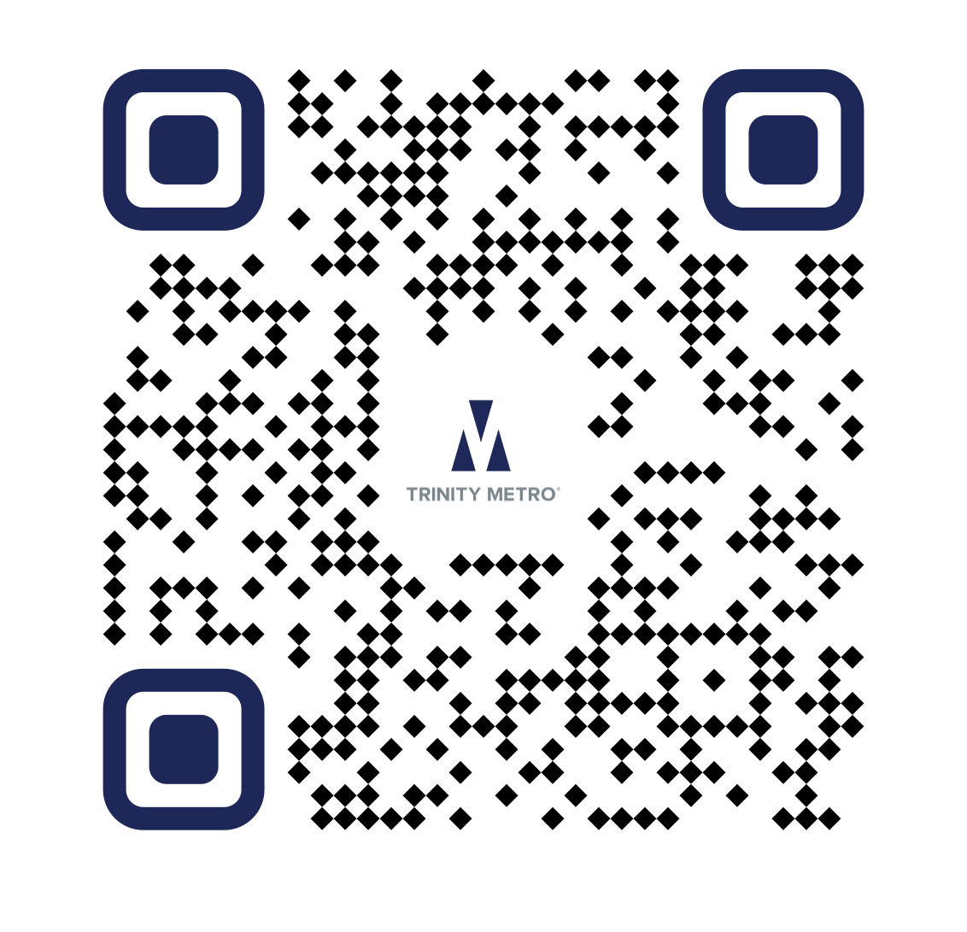
ENGAGE
LEARN
+ SHARE
We’re listening, and we hope you’ll join us.
36

Slide 37
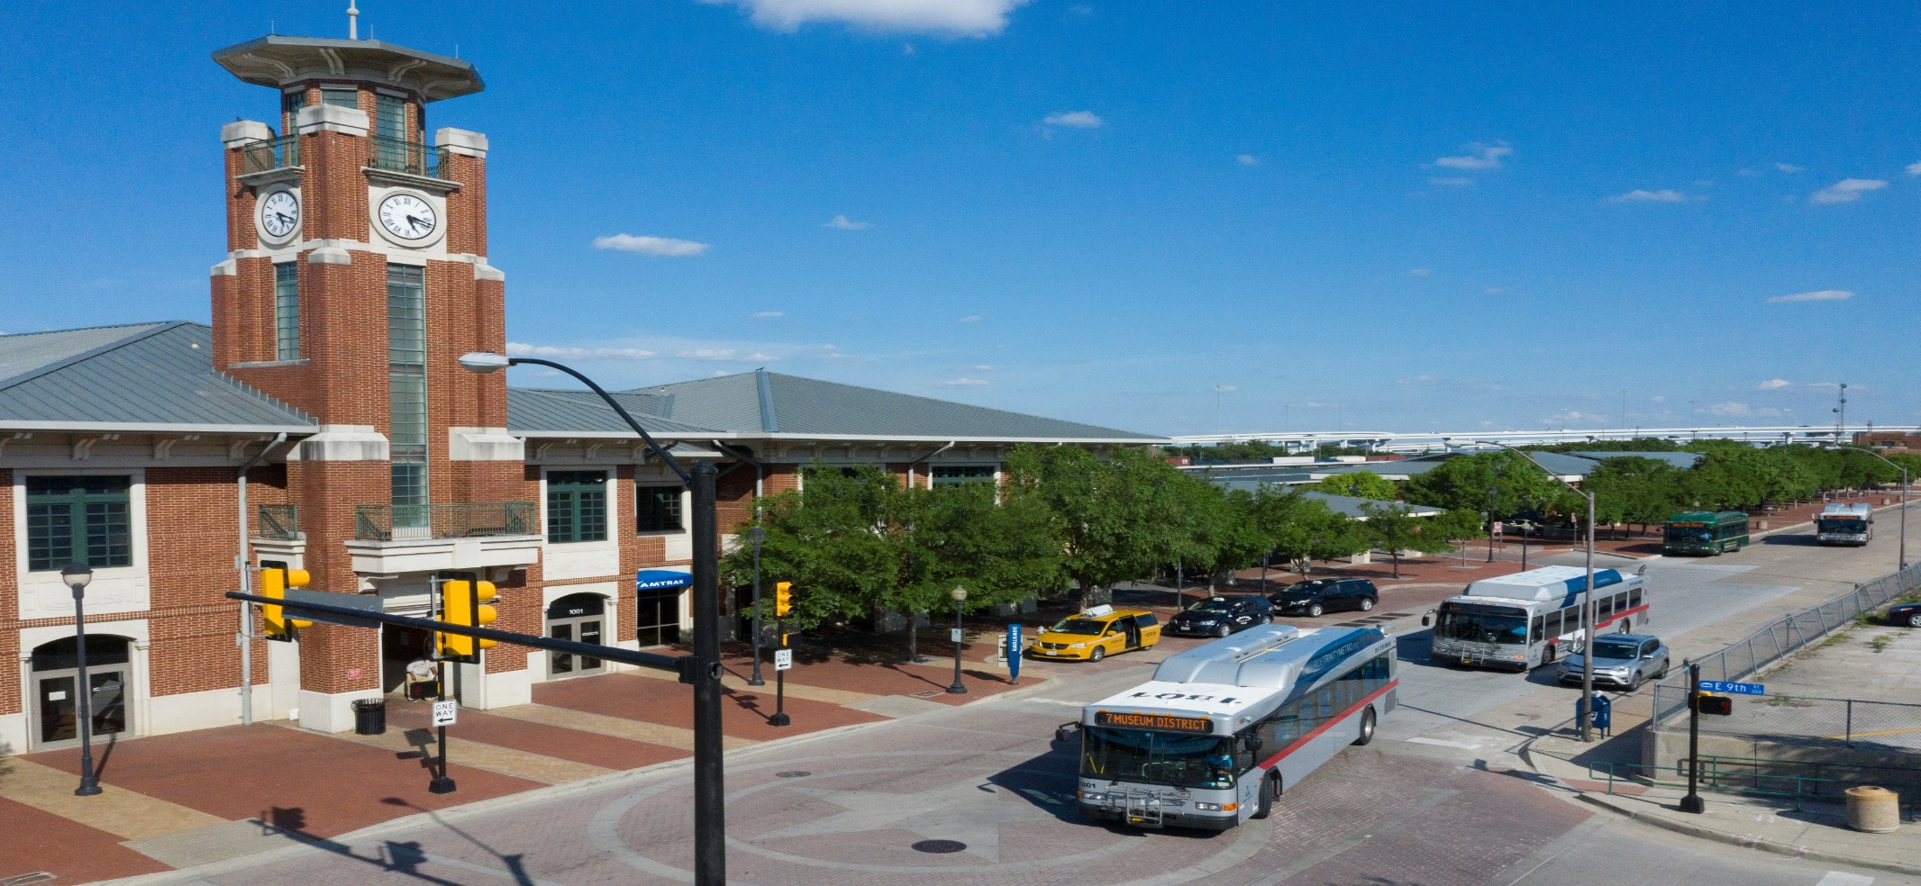
THANK YOU!
37

